Slide 1

What is success?

Slide 2
Make a cartoon to illustrate one of these:
Nothing succeeds like success
Success has many parents
You can’t argue with success
The sweet smell of success
To rest on one’s laurels
The early bird catches the worm
Going from strength to strength
A one hit wonder
Standing on the shoulders of giants

Slide 3


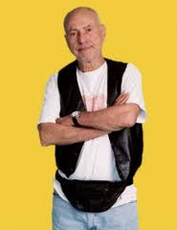
Richard: ‘There are two kinds of people in this world – winners and losers.’
Grandpa: ‘A real loser isn't someone who doesn't win. A real loser is someone so afraid of not winning they don't even try.’

Slide 4

What is your definition of success?

Slide 5
Notes:
Show youtube clip: https://www.youtube.com/watch?v=ws8vIqkMh44 – Derek Redmond Barcelona Olympics

Slide 6
Notes:
Show youtube clip: https://www.youtube.com/watch?v=j8SHYjKuHxc – Perseverance – Faith’s New Shirt

Slide 7

What does it take to achieve success?

Slide 8
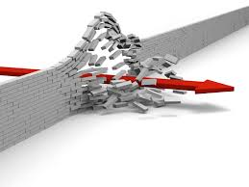
Is success the only worthwhile thing to aim for?
Do the ends justify the means?

Slide 9
Notes:
Show youtube clip: http://www.youtube.com/watch?v=2Fc_og9KLcU - Kielder marathon runner cheat

Slide 10
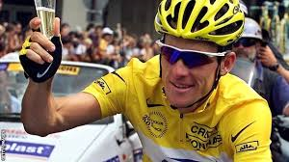
Lance Armstrong

Slide 11
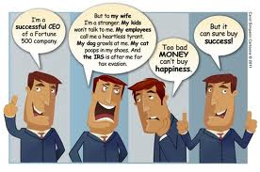

Slide 12
Jesus:
‘What will you gain, if you own the whole world but destroy yourself? What would you give to get back your soul? What kind of deal is it to get everything you want but lose yourself? What could you ever trade your soul for?’

Slide 13
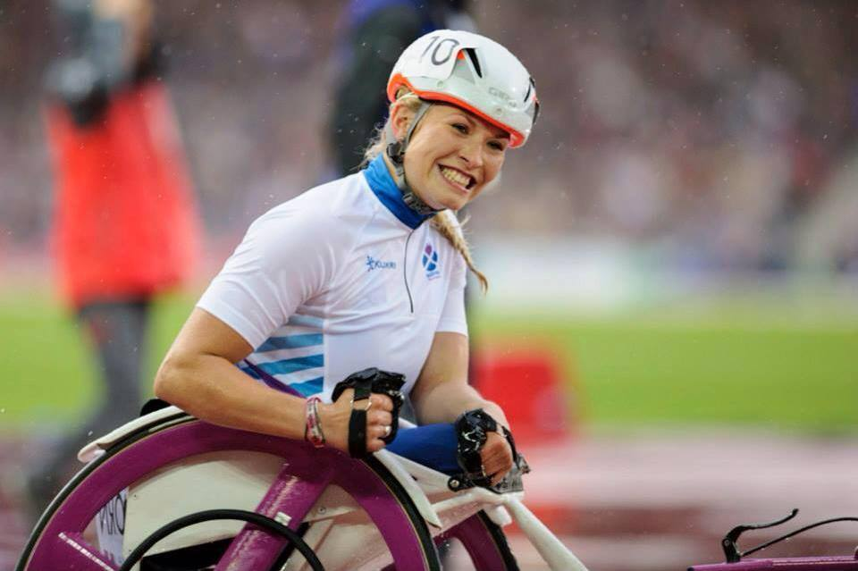
Sam Kinghorn
"I want a gold medal, a world record and to be known the world over for my sport.”

Slide 14

Five
Five will become two when nineties boyband 5ive play at Reading's Sub89 in August.

Slide 15
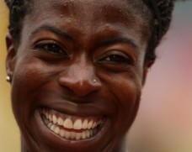
Christine Ohuruogu
I could never have done this without God. My faith helped me understand and come through dark times

Slide 16

What about you?

