Slide 1

TEACHER INSTRUCTION PAGE (delete this slide)
3-2-1 Reading Summary
Student Activity: In this printable activity, students complete a 3-2-1 Graphic Organizer to summarize what they learned.
It also includes pages for vocabulary, reading the article and taking notes, short answer questions, multiple choice questions, and a discussion worksheet for open-ended prompts.
How to share with students: These pages are sized for printing or can be assigned digitally using an LMS (like Google Classroom), where students can work on their own slide decks via “Make a Copy for Each Student.” Each slide is set up with text boxes for students to type in.
Please Note: Because Diffit resources can vary in length, be sure to check the formatting on each slide.
Suggested Lesson Flow:
1. Students record what they notice and what they wonder about the image.
2. Complete the 3-2-1 Graphic Organizer
3. Students read and take notes.
4. Students answer the questions and explain their thinking.
5. Students write answers to the short answer questions.
6. Have students complete the Open Ended Questions and discuss with partners or groups.
Feel free to edit, remix, and use this resource however works best for you and your students! Find editing tips here!
Learn More: Please reach out with any questions or feedback. You can also learn more on our FAQ page, or get more resources at Diffit.me!
TEACHER INSTRUCTION PAGE (delete this slide)

Slide 2
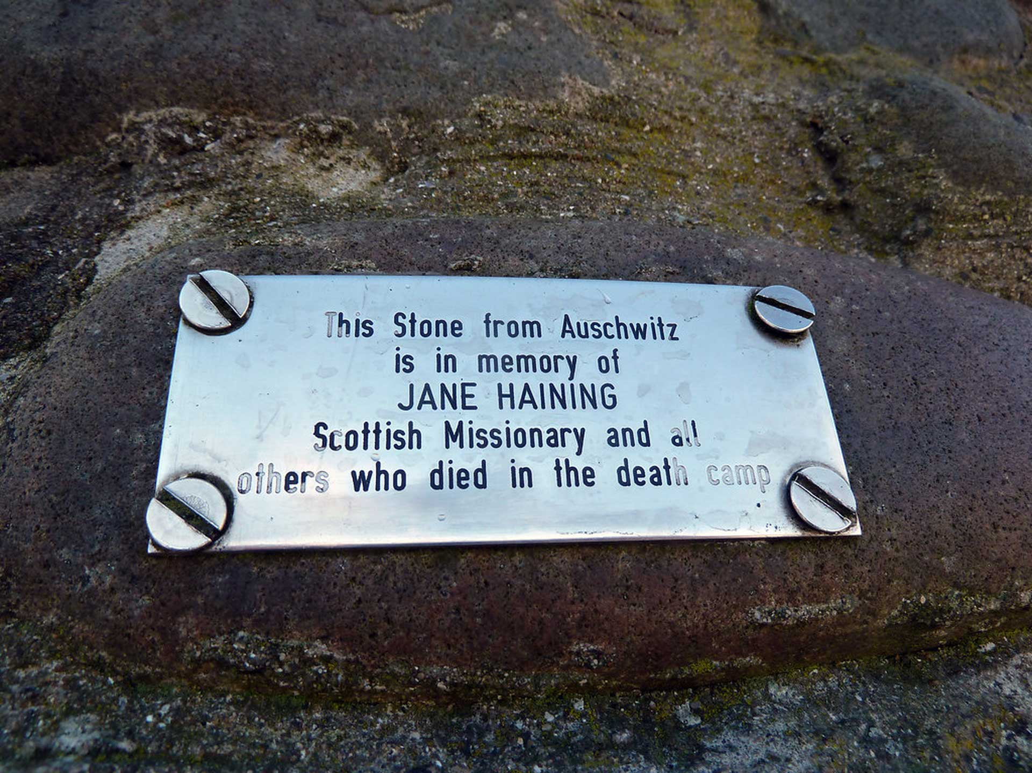

Slide 3
atrocities
commemorate
deport
resolve
prevail
extremely cruel and violent acts, especially those committed by a government or military force.
to remember and celebrate a person or event, especially with a ceremony.
to force someone to leave a country, especially because they are considered to be a danger to society.
firm determination to do something.
to be victorious or successful in the end.

Slide 4
Faith in the Face of Darkness: The Legacy of Jane Haining
Jane Haining – a Scottish Heroine of the Gospel remembered 80 years after her death
On 27 January 2025, the 80th anniversary of the liberation of the German Nazi concentration and extermination camp Auschwitz in Poland will be commemorated. For the world today, Auschwitz is a symbol of the Holocaust and the atrocities of World War II. In 2005 the United Nations declared 27 January as the International Holocaust Remembrance Day.
Until the liberation of some 7 thousand prisoners remaining at the site of the camp by soldiers of the Red Army, the German Nazis murdered approx. 1.1 million people in Auschwitz, mostly Jews, but also Poles, the Roma, Soviet prisoners of war and people of other nationalities.
As the world prepares to commemorate this event, it seems an appropriate time for CVE Scotland to remember a Scottish woman who has been officially honoured for giving her life for Jews in the Holocaust and who died 80 years ago, aged 47, at the concentration camp on 17 July 1944.1
Early life in Scotland
Jane Mathison Haining was born on 6 June 1897 into a farming family in Dunscore, Dumfriesshire. Sadly, her mother passed away at an early age and Jane shared the responsibility of raising her two younger sisters. However, her caring responsibilities did not detract from her studies; she won a scholarship to Dumfries Academy and left school with five Highers and as school dux. Rather than go on to University, which was still rare for women in the early 20th century, she used her qualifications to study at a Commercial College in Glasgow and then take up a position as a junior secretary at JP Coates in Paisley where she worked from 1917-1927.
Photo of Jane at Dumfries High school seated second right.
1 Jane Haining: The Scot who died in Auschwitz - BBC News Steven Brocklehurst 30 November 2014
Haining grew up as a member of the Craig Church in Dunscore, part of the United Free Church of Scotland, Jane later worshipped at Queen's Park West United Free Church in Glasgow, near her living accommodation, and taught children in the Sunday School and was a monitor with the

Slide 5
Band of Hope.
Call to the mission field in Budapest
It was around this time that Jane became interested in becoming a missionary. In 1927 she attended a meeting in Glasgow of the Jewish Mission Committee and heard Rev. Dr. George Mackenzie, chair of the committee, discuss his missionary work. She reportedly told a friend: "I have found my lifework!" She commenced further full-time studies – a one year diploma which gave her a qualification in domestic science and housekeeping and training at a Missionary College in Edinburgh. After responding to an advertisement in the Church of Scotland magazine Life and Work, looking for a matron for the girls' hostel attached to its Jewish mission school in Budapest, Jane moved to Hungary on 20 June 1932, just 7 months before Adolf Hitler became Chancellor of Germany January 1933.
Credit: Queen’s Park Govanhill Church of Scotland website
The mission school (now known as St Columba’s Scottish Church) was open to both Christian and Jewish students with approximately 400 students of whom 30-40 were boarders. Jane took on the caring role for the boarders and used her time working there to show her faith in action by treating and caring for all pupils equally and holding daily bible studies to share the New Testament truths with unbelievers . In a BBC documentary BBC Scotland - Jane Haining: The Scot Who Died in Auschwitz (last shown in 2019) a former pupil said of Jane that she was “kind and welcoming and warm" (Katalin Packard) and "We never felt we were not equal with each other or with the Christian pupils. We did not even notice who was Christian and who was Jewish," said former pupil Dr Zsuzanna Pajzs.
However it was not so welcoming for the Jewish population in the community at large.
According to the Reverend McDougall2, Haining wrote around 1938: "What a ghastly feeling it must be to know that no one wants you and to feel that your neighbours literally grudge you your daily bread.” According to one colleague, she would rise at 5 am on market days to find food for
2 In 1949 a Scottish minister, the Reverend David McDougall (1889–1964), editor of the Jewish Mission Quarterly,[9] published a 21-page booklet, Jane Haining of Budapest the home and would carry the heavy bags back

Slide 6
herself. She is reported to have cut up her leather suitcase to repair the girls' shoes.
The outbreak of WW II
Jane was home on holiday in Cornwall when World War II started in 1939 and showing her love and care for Budapest and the students at the mission school, she rushed back immediately3.
Later in the year, the Church of Scotland advised Haining to return to Britain, but she decided to stay in Hungary, accepting the risks that went along with this decision so sure was she of her call to the work to serve God at the school. Hungary did remain ‘neutral’ for a period of years after the outbreak and took in many Jewish refugees fleeing from the Holocaust in German- occupied Europe.
Rev. George Knight, the mission's superintendent, wrote in 1944, after Haining's death: "During those awful years of the 'war of nerves,' when refugees were pouring out of Germany into the comparative safety of Hungary, the Mission staff spent a hectic time attempting to aid those émigrés to continue their flight to Great Britain and the Western Hemisphere. We established a training school for prospective domestic servants and Miss Haining ... gave courses of lectures to Jewish refugees on British conditions.”4
Whilst Hungary maintained neutrality for nearly five years after the outbreak of WW II, over this period of time the Jewish population began to lose their basic civil rights. Jane remained resolute in her desire to stay where she felt God had placed her in the Church of Scotland Mission School. She wrote, "If these children needed me in days of sunshine, how much more do they need me in these days of darkness?" Her family also pleaded with her to return, however her sister recounted afterwards, “If the children needed her in peacetime, they had much more need of her in war-time and she would never have had a moment’s happiness if she had come home and left them.” 5
Despite being spared from the atrocities in neighbouring countries since 1939, on Sunday 19 March 1944, the German Army invaded Hungary, and the SS marched into Budapest, making plans instantly for the country's Jews to be deported to the concentration and extermination camp at Auschwitz. Jews over the age of six were required to wear a 10 x 10 cm yellow badge in the shape of the Star of David on the left chest of their outer clothing and could be

Slide 7
charged and arrested for minor misdemeanours such as wearing a star of the wrong size. It was reported that Jane “wept as she sewed on the yellow stars that branded her children as Jews.”6
Jane’s arrest and deportation
3 https://www.thenational.scot/news/18486220.jane-haining-scot-lived-died-jewish-children/ Hamish MacPherson 31st May 2020 4 Robertson, Jennifer (Spring 2014). "'An Inspiration to All of Us': Jane Haining of the Scottish Jewish Mission, Budapest" (PDF). Prism. 6: 29–34. ISSN 1949-2707 5 https://qpgparish.wordpress.com/jane-haining/ Queens Park Govanhill Parish Church website 6 Jane Haining: The Scot who died in Auschwitz - BBC News Steven Brocklehurst 30 November 2014 In April 1944 it is believed that Jane had a falling out with a member of the kitchen staff at the school over the theft of food meant for the students. It cannot be confirmed with certainty however it is likely no co-incidence that she was arrested shortly afterward on a series of charges including: -
1. She had worked among the Jews.
2. That she had wept when putting yellow stars on the girls.
3. That she had dismissed her housekeeper, who was an Aryan.
4. That she had listened to the news broadcasts of the B.B.C.
5. That she had many British visitors.
6. That she was active in politics.
7. That she visited British prisoners of war.
8. That she sent them parcels
Jane admitted all charges except number 6 as she was not actively involved in politics. On her death certificate the Nazi authorities stated she was arrested on account of “justified suspicion of espionage against Germany .”7
According to the Polish historian Danuta Czechi8, Jane was deported to Auschwitz II on 15 May 1944. Rev David McDougall stated, she was taken to Auschwitz along with 90 other prisoners from the Kistarcsa transit camp.
The journey will have been horrendous. Packed into closed goods wagons in the summer heat, the Hungarian trains travelled to the

Slide 8
Slovak border, then prisoners were transferred to German trains to be taken to Auschwitz, a journey of about two days. Jane will have had little air, light, food or water, with buckets for latrines and no privacy. Many people died during the journey.
There were prisoners in Auschwitz from almost every country in Europe, and even some non- Europeans.9 One former pupil of the school said that many of the Jewish girls from the Scottish mission also ended up in Auschwitz; a few survived including world famous social activist and humanitarian Professor Eve Hallard who escaped Nazi persecution with the help of Jane at the mission school.10 About 90 per cent of the Hungarian Jews who survived the journey to Auschwitz were sent immediately to the gas chambers on arrival; the rest were selected for slave labour.11
7 McDougall, David (1998). Alexander, Ian (ed.). Jane Haining 1897–1944. Edinburgh: The Church of Scotland World Mission 8 Danuta Czech (Auschwitz, 1940–1945. Central Issues in the History of the Camp, Volume V, 2000) 9 https://www.auschwitz.org/en/history/categories-of-prisoners/other-ethnic-groups 10 http://www.gcu.ac.uk/newsevents/news/article.php?id=72733 11 Braham, Randolph L. (1998). "Hungarian Jews". In Gutman, Yisrael; Berenbaum, Michael (eds.). Anatomy of the Auschwitz Death Camp. Bloomington: Indiana University Press. pp. 456– 468. ISBN 0-253-32684-2.
Jane’s death at Auschwitz Camp, Poland
Being a Christian and British, Jane was treated as a political prisoner and allocated prisoner number 79467, which she likely had tattooed on her arm like all other prisoners. Poignantly, with her heart still with the work she did for the Lord, Jane sent a postcard from Auschwitz to Margit Prém Principal of the mission school in German, dated 15 July 1944, asking politely for fresh fruit, biscuits and bread, mentioning how she could see mountains going up to Heaven, and referring to a previous letter sent of which there is no record.12
Jane survived just two months at Auschwitz and died on 17 July 1944 aged just 47. According to her death certificate, she died of "cachexia following intestinal catarrh". It was originally thought that Jane died in hospital however it is likely that this was disinformation from the Nazi forces as the full horror of Auschwitz was not fully known by most in the UK at that time.13

Slide 9
Jane may have died of disease at the camp or even possibly was gassed with many other females who were too ill to carry out the work demanded of them by Camp officers.
Recognition and Memorials
Jane’s bravery and service to her Lord and to the Jewish pupils at the mission school was recognized on 27 January 1997 by Yad Vashem in Israel as Righteous Among the Nations for having risked her life to help Jews during the Holocaust. She is the second Scot to be recognised in this way and her name is featured in the Garden of the Righteous in Jerusalem. Her sister, Agnes O’Brien (age 75 at the time) took part in a ceremony at Glasgow’s Museum of Religious Life along with Church of Scotland senior members, including the Rt. Rev. Sandy McDonald (father of actor David Tennant).
It is still possible to see the medal and certificate she was posthumously awarded at the now re- named St Mungo Museum of Religious Life and Art. The museum is open Monday-Thursday, Saturday: 10am-5pm and Friday, Sunday: 11am-5pm. Entry is free.
12 Szeretettel, Jane / With love, Jane (Jane Haining) (youtube.com) 13 https://blog.britishnewspaperarchive.co.uk/2021/03/18/remembering-jane-haining/ Rose Staveley- Wadham
Additional memorials to Jane include plaques at her former school Dumfries Academy, a cairn near Dunscore Church, and the Jane Haining rakpart (Jane Haining quay) in Budapest, named for her in 2010.14 The rakpart was in the news in October of this year after Storm Boris threatened greater flooding and Church of Scotland volunteers helped to protect them. 15o in 2010, the British government named her a British Heroine of the Holocaust.
In May 2024, exactly 80 years after her arrest, Jane was honoured, along with mission school principal Margit Prém, at the bag-piped unveiling of a new memorial outside St Columba’s Church of Scotland in Budapest16
Her former minister, Rev J. L. Craig said in tribute, No one can assess the value of her wholehearted service of love. That is God’s secret. But of this we can be sure—she must have made a lasting impression upon the hearts and minds of the girls who came under her influence; and they in their turn will transmit to others something of what they received from her; and so through successive generations the effect of her work will be felt.

Slide 10
17

Slide 11
1. Why did Jane Haining decide to stay in Budapest during World War II, even though the Church of Scotland advised her to return to Britain?
A) She believed it was her duty to stay and care for the children at the mission school.
B) She was afraid to leave her friends and colleagues in Budapest.
C) She wanted to be closer to her family in Scotland.
D) She disagreed with the Church of Scotland's decision and wanted to prove them wrong.
2. What was the main reason Jane Haining was arrested by the Nazi authorities?
A) She was accused of being a spy for the British government.
B) She was accused of stealing food from the mission school.
C) She was accused of helping Jewish children escape from Hungary.
D) She was accused of being a political activist against the Nazi regime.
3. What did Jane Haining do that led to her being recognized as "Righteous Among the Nations" by Yad Vashem?
A) She donated a large sum of money to help Jewish refugees.
B) She organized protests against the Nazi regime in Hungary.
C) She risked her own life to help Jewish children during the Holocaust.
D) She wrote a book about her experiences in Budapest during the war.

Slide 12
Short Answer Questions
1. What was Jane Haining's occupation before she became a missionary?
2. What happened to the Jewish population in Hungary after the German Army invaded in 1944?
3. What was the name of the mission school where Jane Haining worked in Budapest?

Slide 13
1. Jane Haining chose to stay in Budapest and care for the Jewish children even when it was dangerous. What are some things you have done that were difficult but important to you?

Slide 14
2. The text describes how Jane Haining was arrested for helping Jewish children. What are some ways people can be persecuted for their beliefs or actions today?

Slide 15
3. Jane Haining was recognized as a Righteous Among the Nations for her bravery. What are some ways you can be a voice for those who are being treated unfairly?

