Slide 1
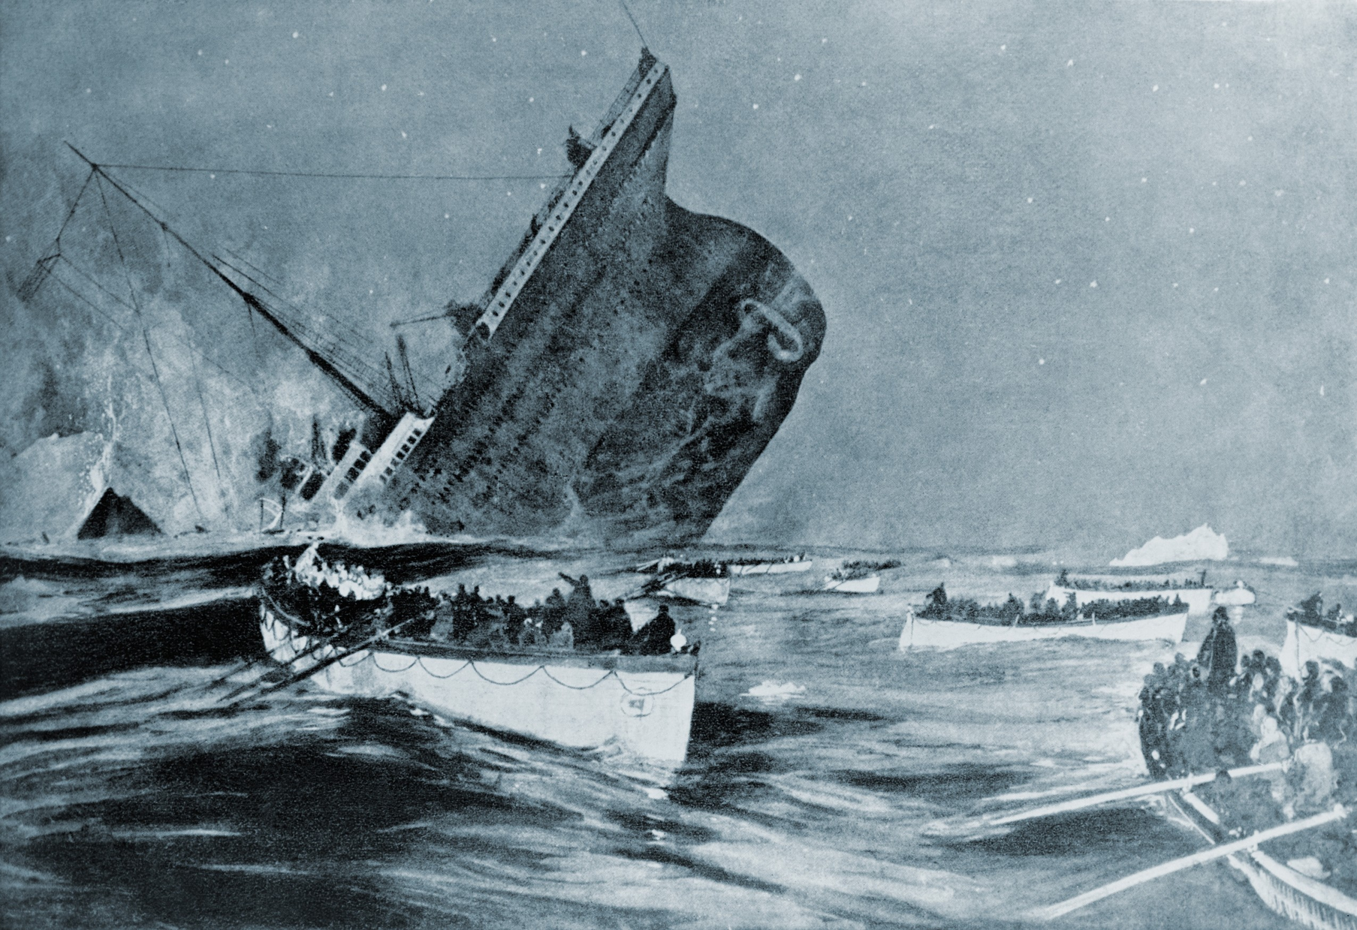
John Harper: Faith and Heroism Aboard the Titanic
The impact of one Scottish minister’s Christian witness

Slide 2
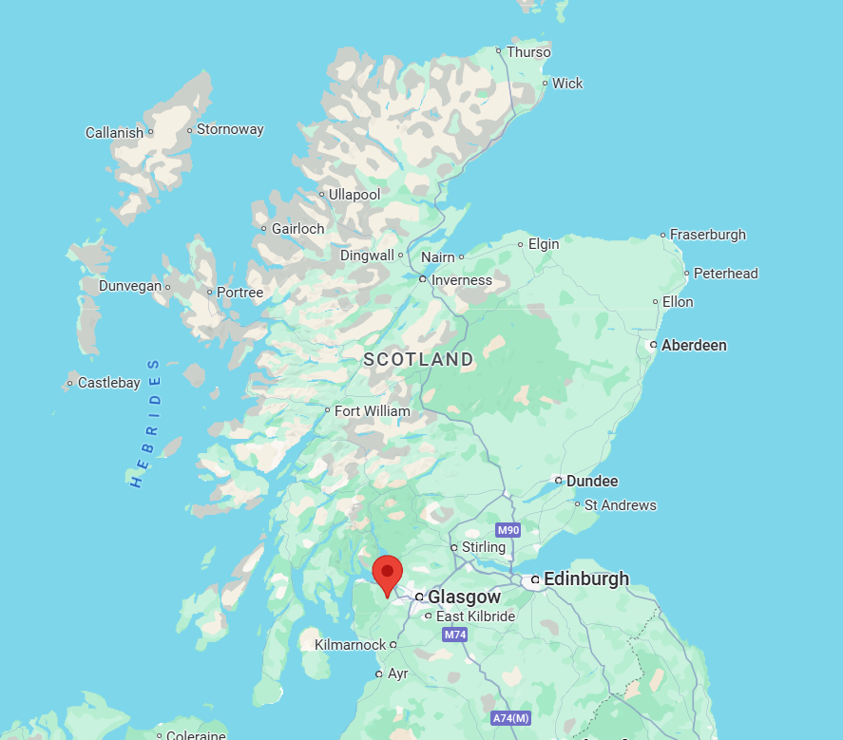
  John Harper was born in 1872 in the village of Houston, Renfrewshire
  He put his trust in God and accepted Christ as his saviour at the age of 14
  At the age of 18, he started preaching

Slide 3
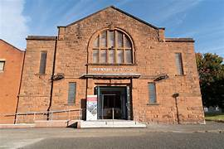
  In 1897 he was called to be the first pastor of Paisley Road Baptist Church (The Tin Kirk)
  The congregation grew from 25 to 500 during the 13 years he was there
Harper Church, Govan Glasgow

Slide 4
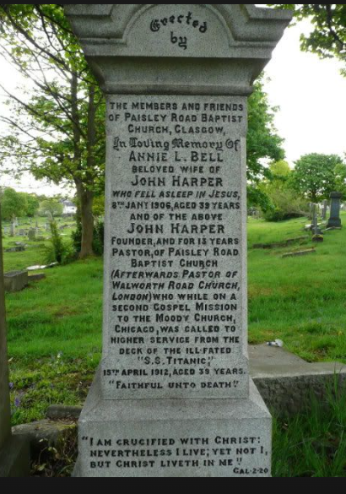
  Sadly John’s wife Annie died just days after giving birth to their daughter, known as Nana, in January 1906
  In 1912 he accepted an invitation to visit to preach at the Moody Church in Chicago
o

Slide 5
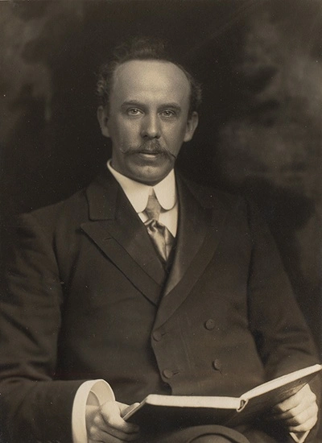
  Sadly John’s wife died just days after giving birth to their daughter Annie in January 1906
  In 1912 he accepted an invitation to visit to preach at the Moody church in Chicago
o

Slide 6
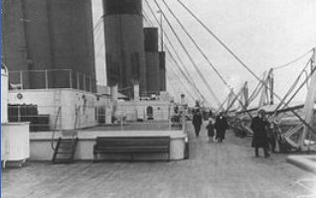
  John, his niece Miss Jessie Leitch and his daughter Nana boarded the RMS Titanic in Southampton on Wednesday 10th April 1912
  This photo taken on the 2nd class promenade deck of the Titanic and is widely regarded to show John and his daughter
o
Image source: Wikipeida Commons

Slide 7
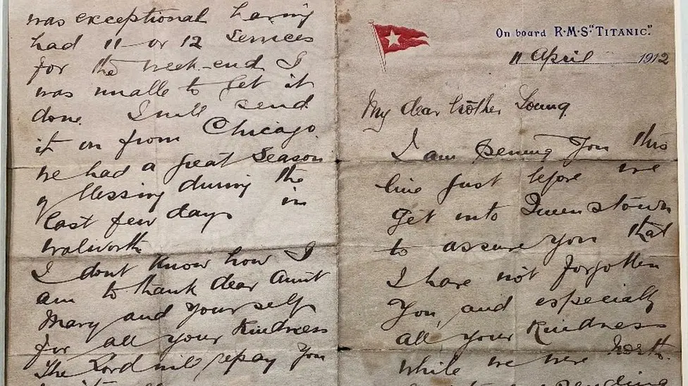
A letter written by John on boad the Titanic to a member of the Paisley Road Baptist Church (now known as Harper Church), and posted at its last port before departing for New York, was sold in 2020 for £42,000
o
Titanic letter by 'brave' pastor John Harper sells for £42k - BBC News
Image Credit: Henry Aldridge and Sons auctioneers
Your paragraph text

Slide 8
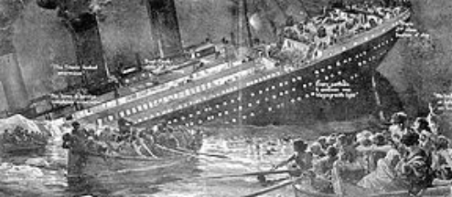
On Sunday 14 April at 23:40 board time, the Titanic collided with an iceberg and sank
in the North Atlantic. Of the approximate 2,200 people on board, over 1,500 did not survive.
Image source: Wikipeida Commons

Slide 9
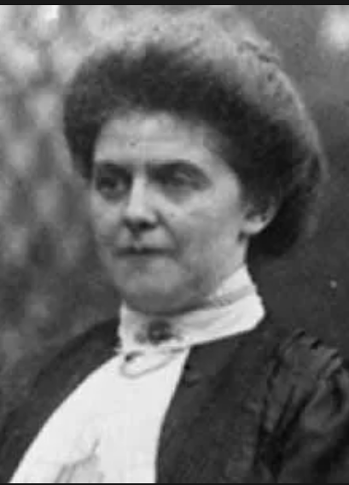
Jessie Leitch later recalled the events on the night of the sinking:
"... About midnight Mr Harper came to our stateroom and told us that the vessel had struck an iceberg. While I was dressing he went to learn further particulars and returned to say that the order had been given to put on the life belts. We did so, and, picking up Nana in his arms, he took her up to the deck. There the women were ordered to the upperdeck. I had to climb a vertical iron ladder and Mr Harper brought Nana after me up the ladder and the men at the top lifted her up to me again... There was no opportunity for farewell, and, in fact, even then we did not realize the danger, as we were assured again and again that the vessel could not sink, that the Olympic would be alongside at any minute, and that the women and children were to be put into the boats first and the men to follow, and that there were boats sufficient for all. Our boat was well manned--it was the eleventh to leave the vessel... After about half an hour the Titanic went down. We were about a mile away."
I
https://www.encyclopedia-titanica.org/

Slide 10
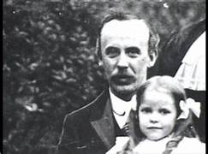
Accounts indicate that John Harper was leading men and women to know the saving grace of our Lord and Saviour before they drowned, asking of one man ”Has your soul been saved?”
Upon the negative response he gave the man his life vest.
The man survived to tell the story of John Harper but Harper’s life in this world ended.
https://harperchurch.org.uk/history/

Slide 11
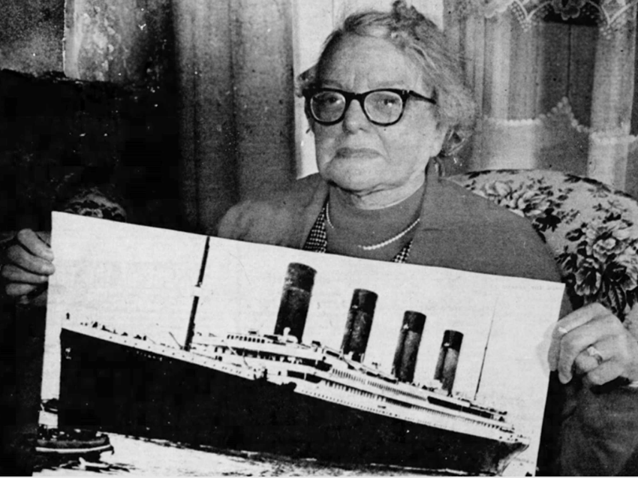
  Nana returned to the UK and in 1921 performed the opening ceremony of Harper Memorial Baptist Church in Govan
  Her husband was also a Baptist minister and she died exactly 74 years to the day when Titanic departed from Southampton on 10 April 1986.
Image credit: Gavin Belll Daily Record 1977

Slide 12
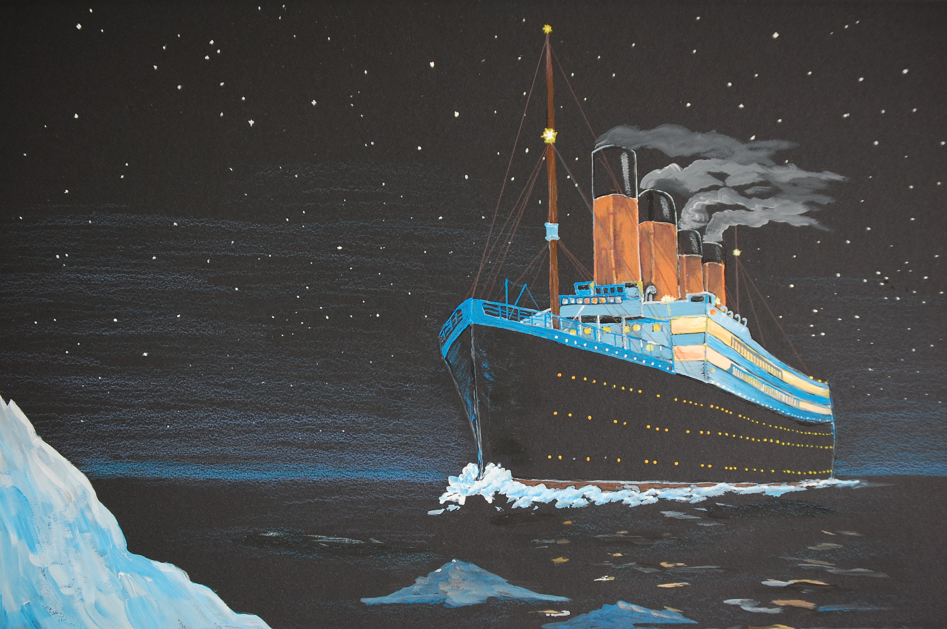
John Harper's Titanic Legacy - 5 minute YouTube video
https://youtu.be/J25StleSQG8

