Slide 1
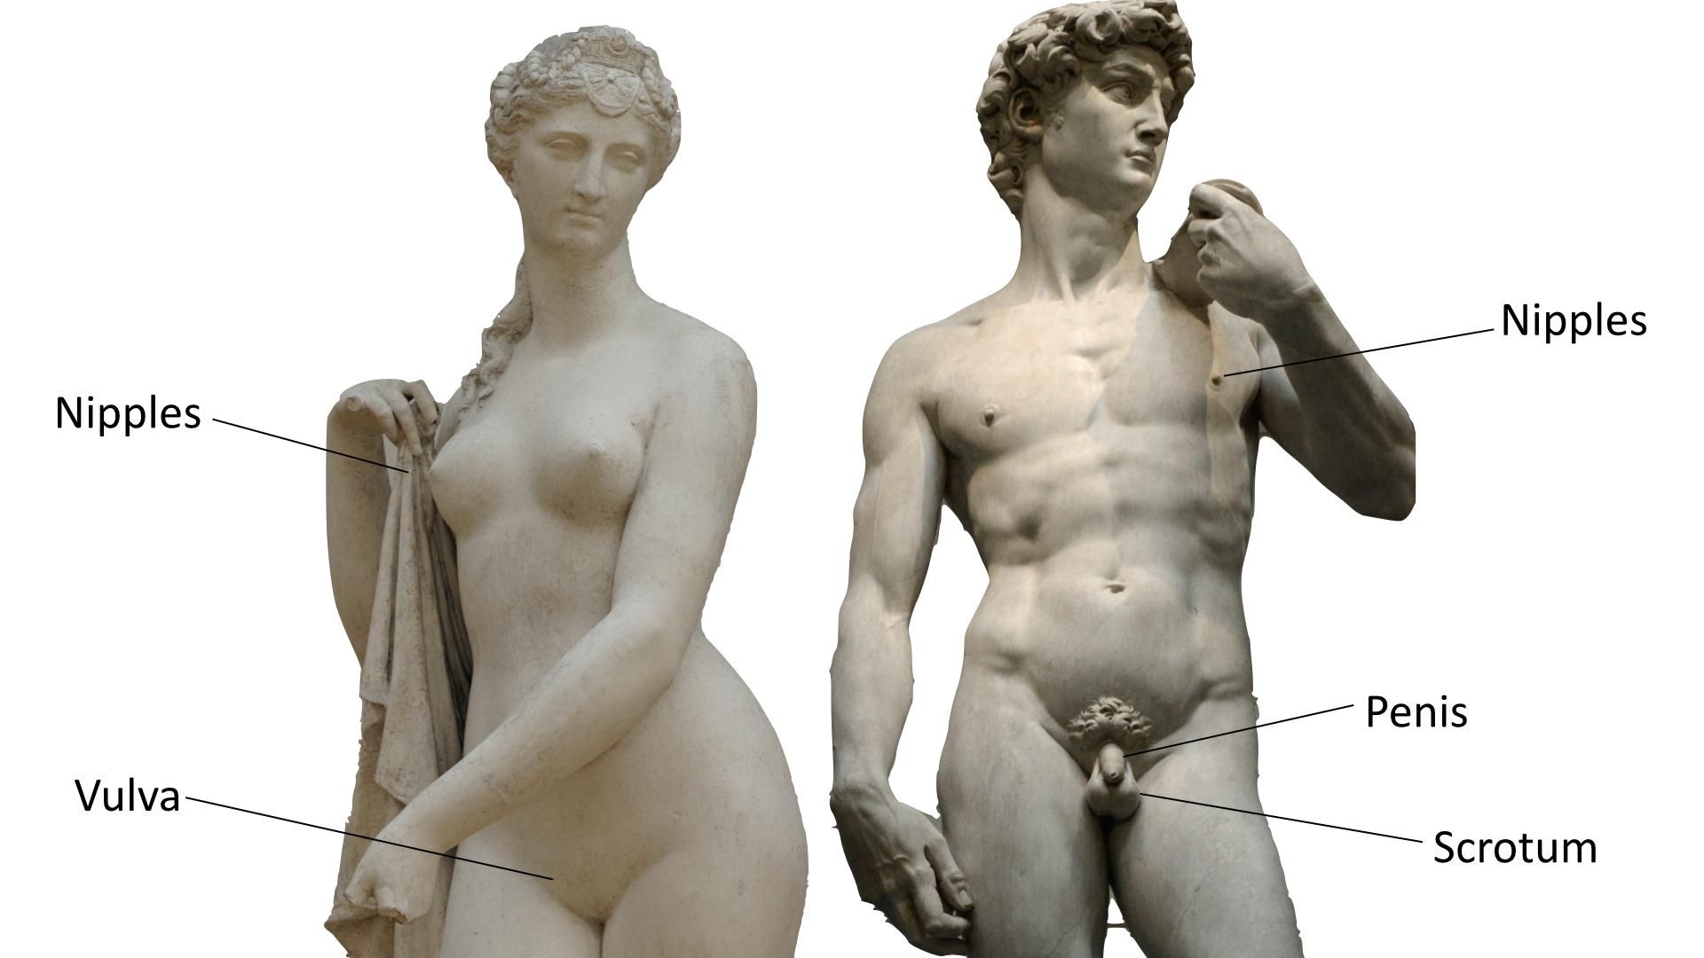
Notes:
Slide 7
Images used are free to use from Unsplash
Female Statue Photo by Margot Noyelle on Unsplash
David Statue Photo by Alex Ghizila on Unsplash

Slide 2
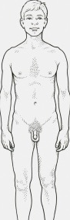
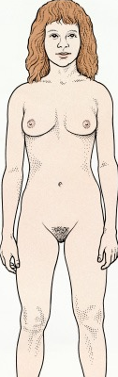
Nipples
Nipples
Penis
Vulva
Scrotum
Notes:
Slide 7 alternative

Slide 3
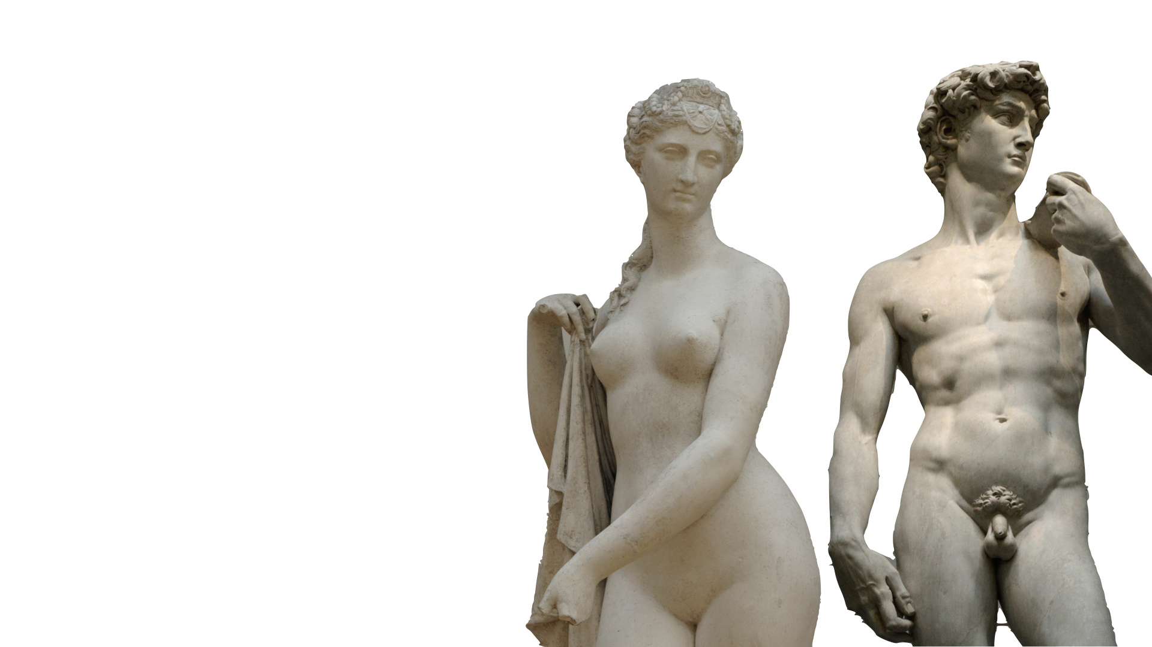
The genitals are the private parts of our bodies. For the boy the penis and scrotum and for a girl the vulva.
Connected to our genitals, inside our body, are parts of our body called reproductive organs because they are used to make a baby.
Notes:
Slide 8
Images used are free to use from Unsplash
Female Statue Photo by Margot Noyelle on Unsplash
David Statue Photo by Alex Ghizila on Unsplash

Slide 4
The genitals are the private parts of our bodies. For the boy the penis and scrotum and for a girl the vulva.
Connected to our genitals, inside our body, are parts of our body called reproductive organs because they are used to make a baby.
Notes:
Slide 8 alternative

