Slide 1
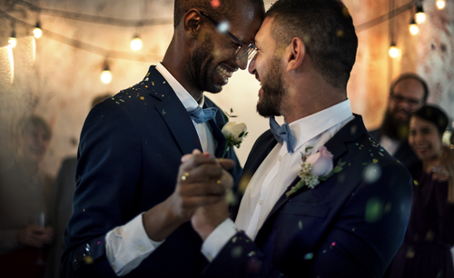
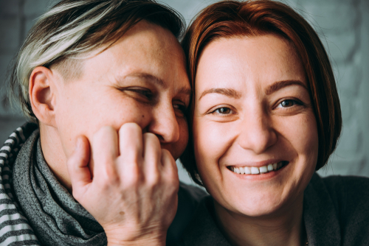
We say a person is gay when a person loves or is attracted to someone of the same sex. This can be two men together or two women together. We can also say that women who love or are attracted to each other are lesbians.
Notes:
Slide 2

Slide 2
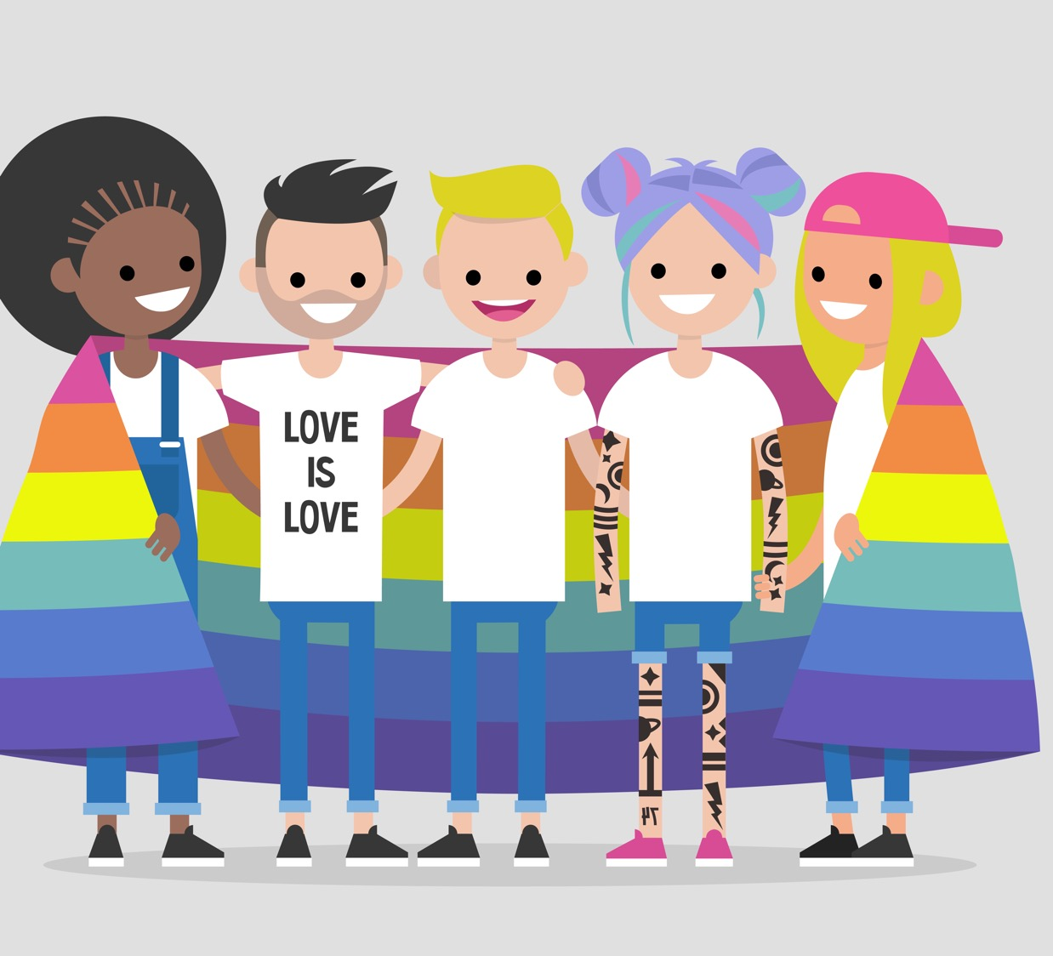
We say a person is bisexual when they feel they can be in love with or attracted to a person who is the same sex as them, or someone of a different sex.
Notes:
Slide 3

Slide 3
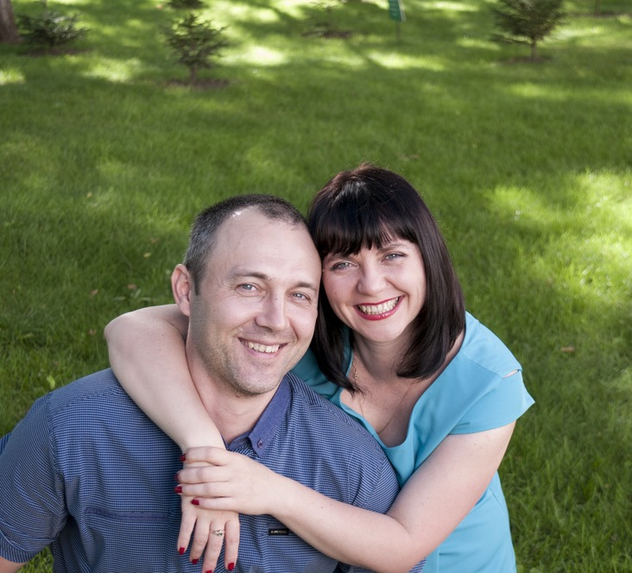
We say a person is heterosexual is when people of a different sex love or are attracted to each other - so a woman and a man.
Notes:
Slide 4

Slide 4
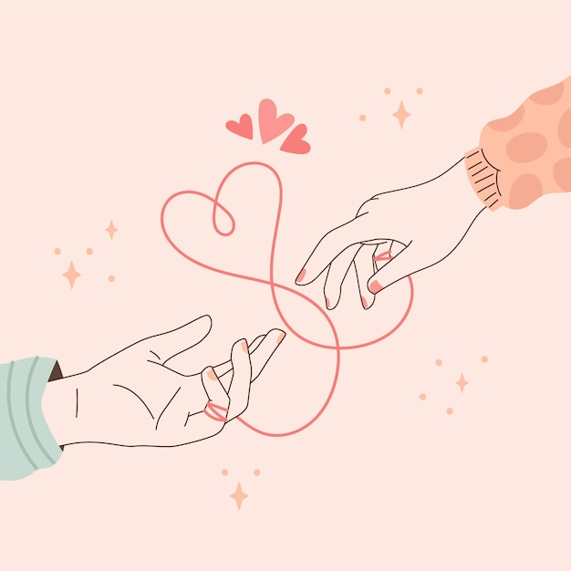
What is love?
Notes:
Slide 5 – Image by Freepik (https://www.freepik.com/free-vector/hand-drawn-red-thread-illustration_35274664.htm#fromView=search&page=1&position=38&uuid=4bdeb78c-ad1b-4ef5-b9c1-ed6e0d5e723d)

Slide 5
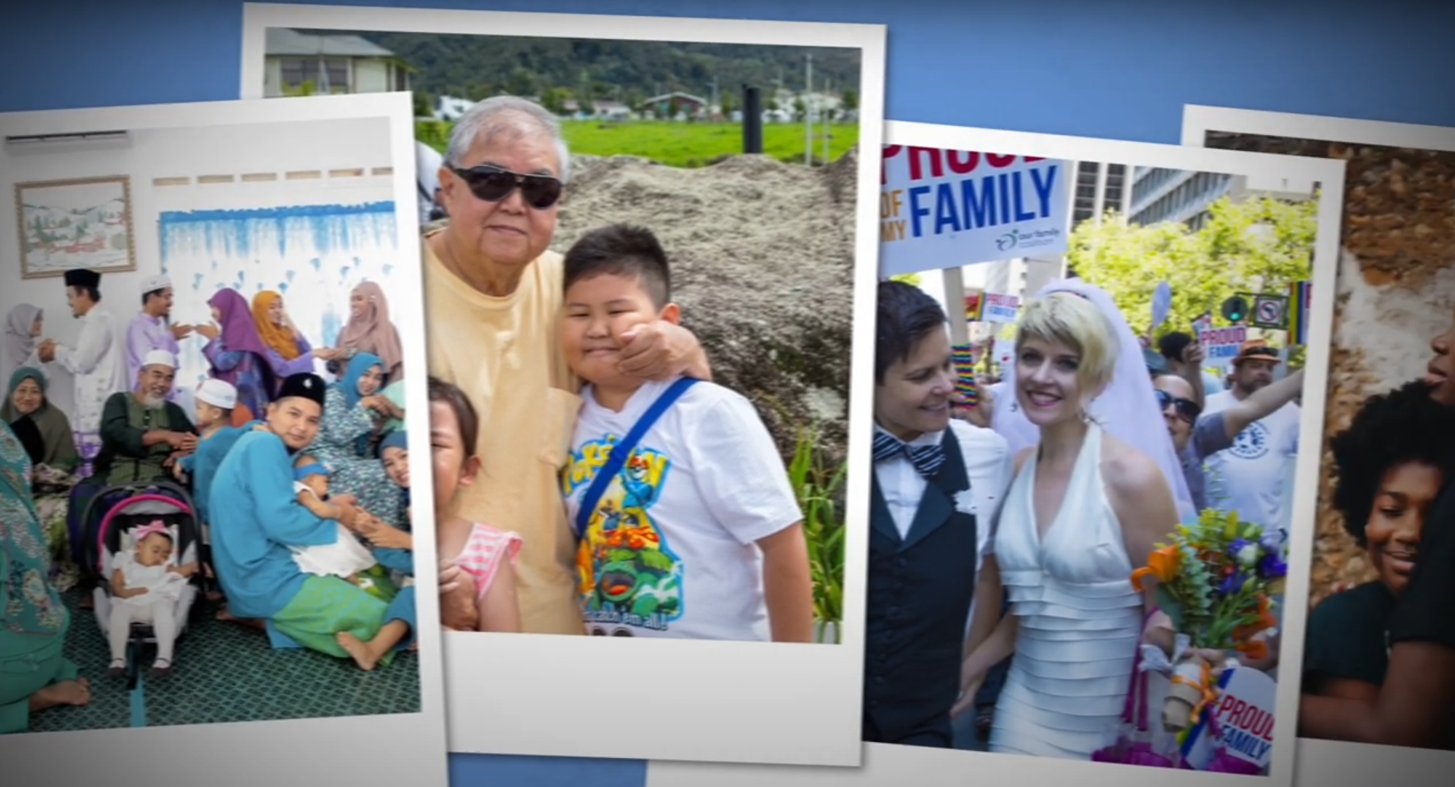
How are families around the world the same and different?
Notes:
Slide 11

