Slide 1
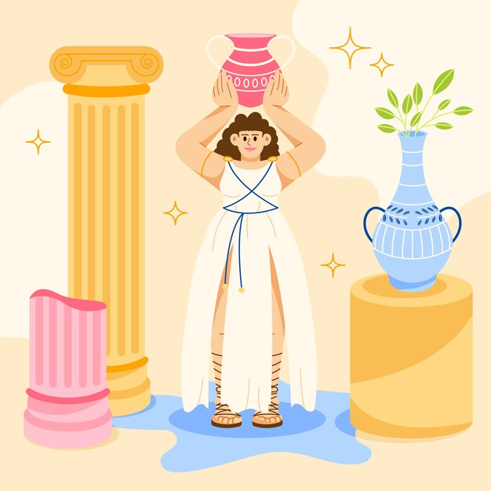
Many kinds of love
Although there is only one word in English, ‘I love my brother’ does not mean the same thing as ‘I love tacos’!
The Ancient Greeks had at least eight different words to describe love!
Notes:
Insert Slides 1-6 of this PPT after slide 2 ‘What is love?’ on the RSHP.Scot PPT. by Freepik - https://www.freepik.com/free-vector/hand-drawn-flat-design-mythology-illustration_25536212.htm#query=ancient%20greece&position=7&from_view=search&track=ais&uuid=fcba3648-7289-462e-8a08-e8348ab8a4d7

Slide 2
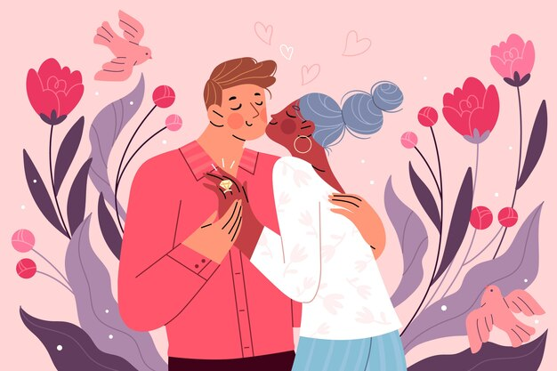
Eros is the romantic love between people who are attracted to each other. Like boyfriends, girlfriends, husbands or wives.
Eros
Notes:
Insert Slides 1-6 of this PPT after slide 2 ‘What is love?’ on the RSHP.Scot PPT
Image by pikisuperstar on Freepik- https://www.freepik.com/free-vector/flat-propose-day-illustration_35806864.htm#query=romantic%20love&position=19&from_view=search&track=ais&uuid=a8d19e27-8901-4fc5-a951-fdb032907327

Slide 3
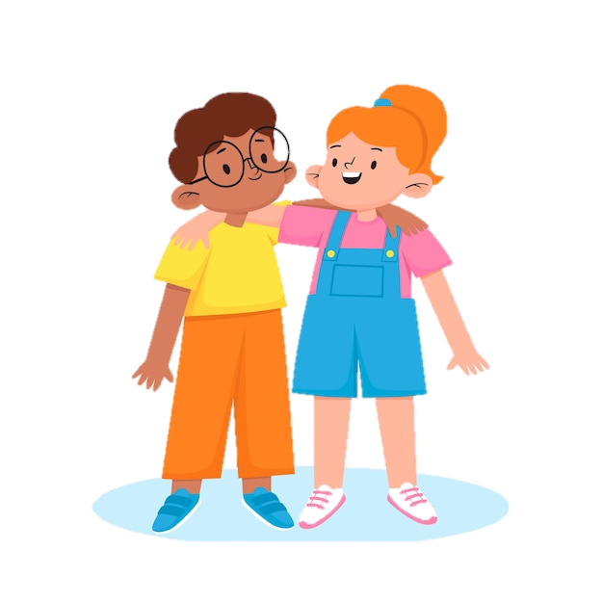
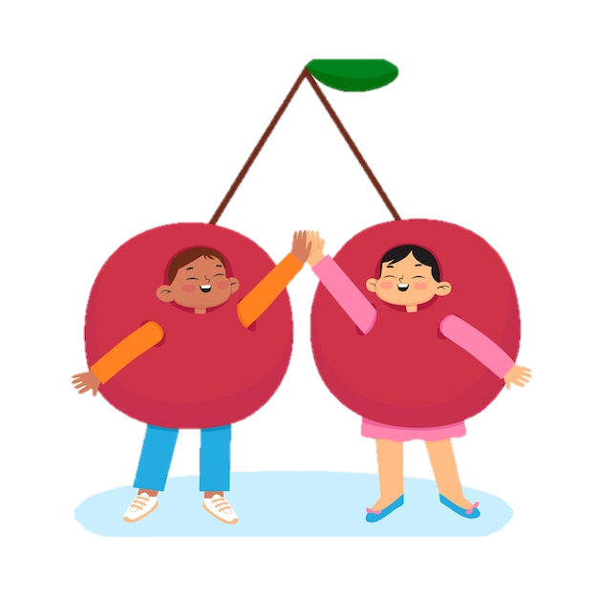
Philia is the love between close friends. Plato, a famous Greek philosopher thought this love was the best kind!
Philia
Notes:
Insert Slides 1-6 of this PPT after slide 2 ‘What is love?’ on the RSHP.Scot PPT
Images by Freepik - https://www.freepik.com/free-vector/hand-drawn-friends-cartoon-illustration_44419114.htm#query=close%20friends%20kids&position=2&from_view=search&track=ais&uuid=6b3293c8-5fc8-4c9d-bc69-b1d5752d5534
Cherries - https://www.freepik.com/free-vector/hand-drawn-friends-cartoon-illustration_44419109.htm#from_view=detail_serie

Slide 4
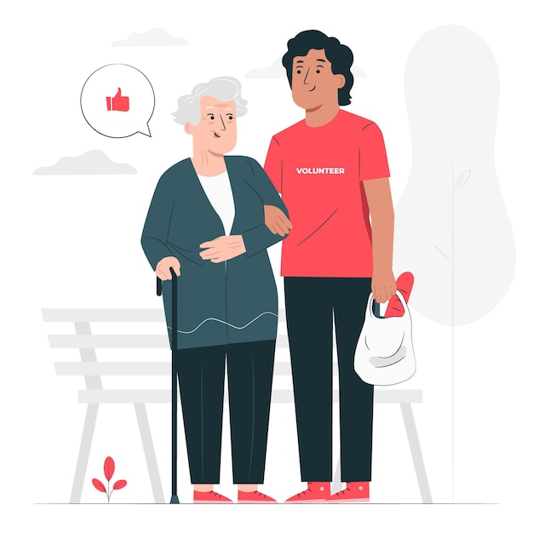
Agape means unconditional love. This is a kind of love that puts someone else first, and might also describe the love we can have for all of humanity. Some people think it is the most important kind of love.
Agape
Notes:
Insert Slides 1-6 of this PPT after slide 2 ‘What is love?’ on the RSHP.Scot PPT
Image by storyset on Freepik - https://www.freepik.com/free-vector/volunteering-concept-illustration_8673346.htm#query=caring%20for%20others&position=23&from_view=search&track=ais&uuid=e57a25a9-10a2-48d1-96ec-811f75ae3bf2

Slide 5
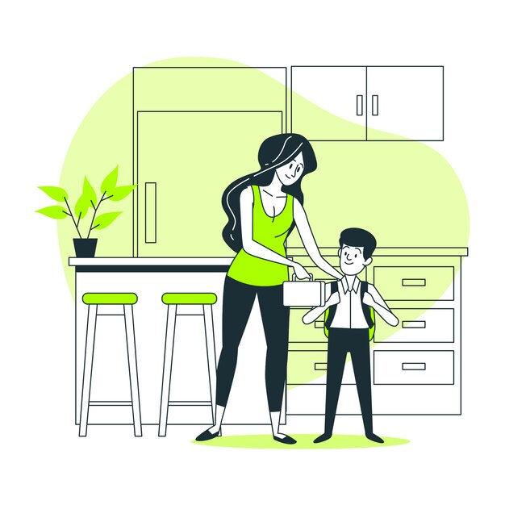
Storge is the natural or instinctive affection you have with family.
If you have a sibling, you might say that you love them, even if you don’t like them sometimes!
Storge
Notes:
Insert Slides 1-6 of this PPT after slide 2 ‘What is love?’ on the RSHP.Scot PPT
Image by storyset on Freepik - https://www.freepik.com/free-vector/back-school-concept-illustration_7176403.htm#query=family&position=6&from_view=search&track=sph&uuid=cfb8fa88-7faf-4c6c-aaf4-4e6ad26c3d97

Slide 6
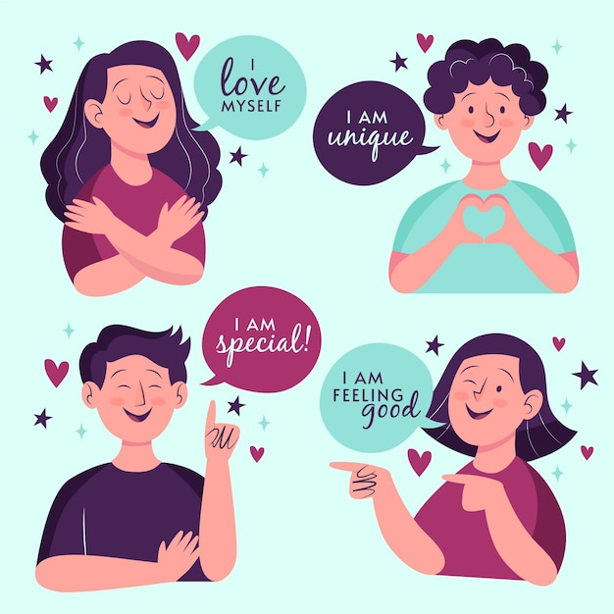
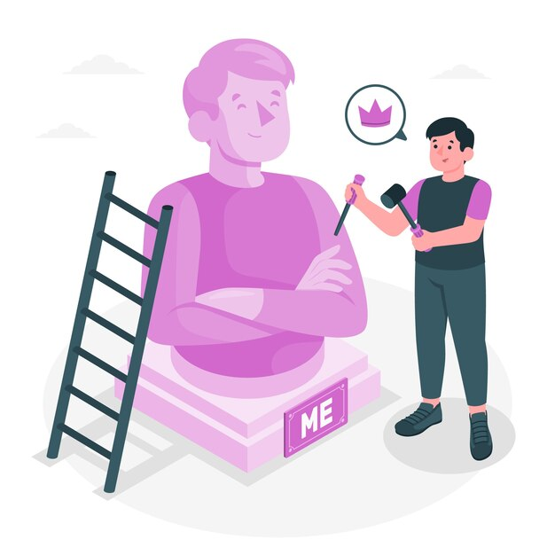
Philautia
Philautia means self-love. This can be healthy – like taking care of and being kind to yourself.
Or it can be unhealthy – when you are very selfish and don’t care about others.
Notes:
Insert Slides 1-6 of this PPT after slide 2 ‘What is love?’ on the RSHP.Scot PPT
Image by Freepik - https://www.freepik.com/free-vector/high-self-esteem-illustration_11107525.htm#query=self%20love&position=13&from_view=search&track=ais&uuid=e88ddbb9-c612-4e39-a72f-9c305306370c
Statue image by storyset on Freepik - https://www.freepik.com/free-vector/ego-concept-illustration_72631729.htm#query=ego&from_query=egotistical&position=0&from_view=search&track=sph&uuid=c9166ae5-b3ab-4201-906d-c0c824eeb345

Slide 7
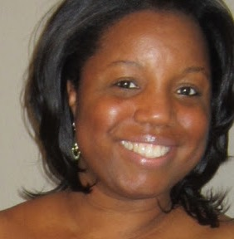
“When you love who YOU are, your relationships will be healthier and your life will be happier.
Self-love sets the standard in how we allow others to treat us and how we treat ourselves. Your happiness and well-being is important. Protect it by always valuing who you are!”
Stephanie Lahart (Author)
Notes:
Slide 10

Slide 8
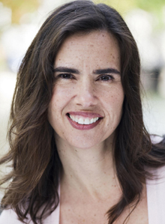
“With self-compassion, we give ourselves the same kindness and care we’d give to a good friend.”
Dr. Kristin Neff (Psychology Professor)
Notes:
Slide 10 alternative

