Slide 1
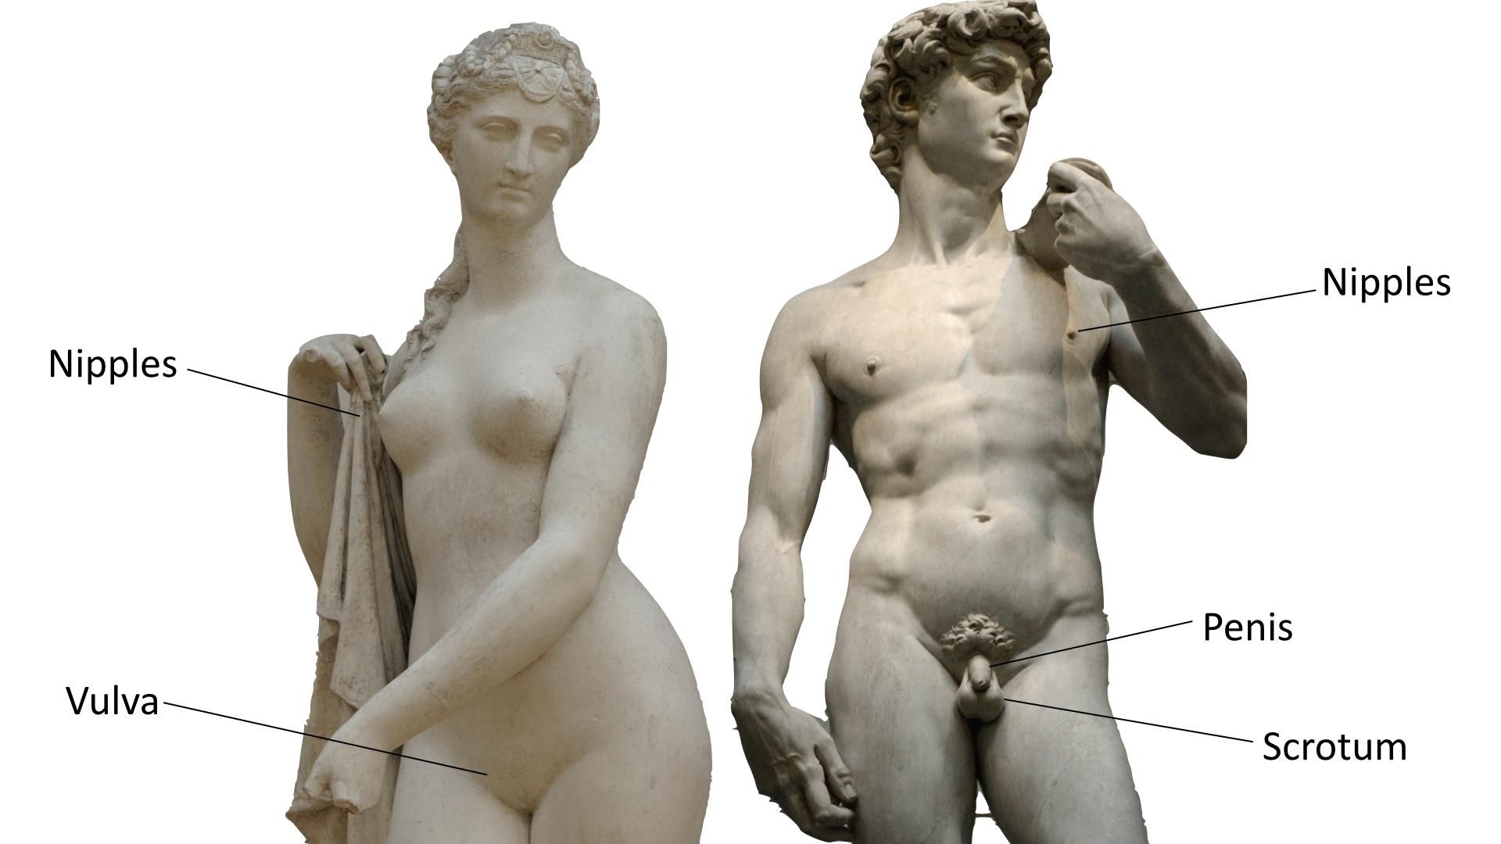
Recap:
Names of parts of the body
Notes:
Slide 2
Images used are free to use from Unsplash
Female Statue Photo by Margot Noyelle on Unsplash
David Statue Photo by Alex Ghizila on Unsplash

Slide 2
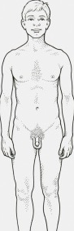
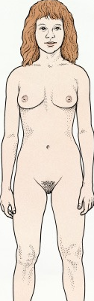
Recap:
Names of parts of the body
Nipples
Nipples
Penis
Vulva
Scrotum
Notes:
Slide 2 alternative

Slide 3
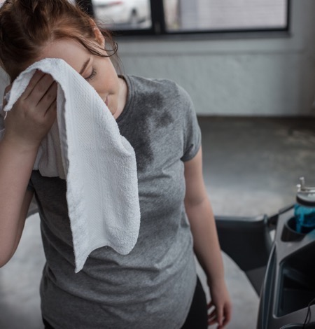
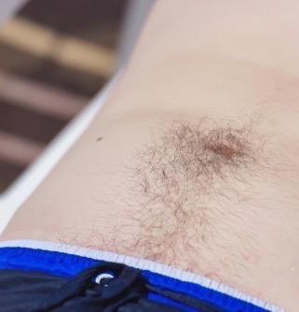
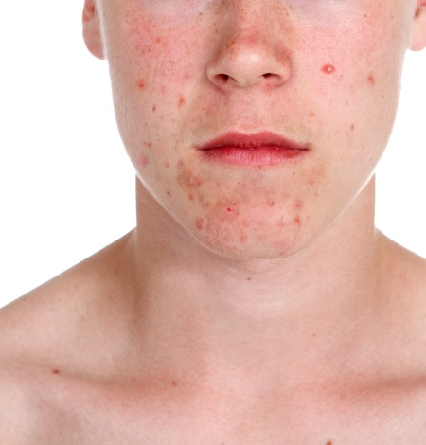
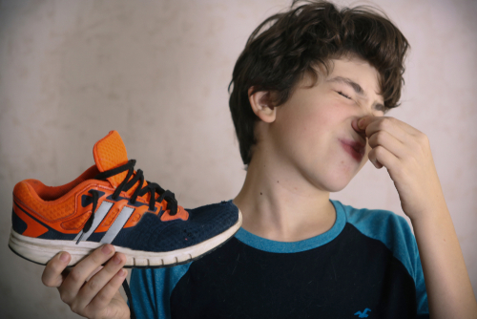
When we go through puberty what happens to:
Hair?
Voices?
Breasts?
Skin?
Smell?
Body shape?
Notes:
Slide 3

Slide 4

In Scotland, the law says you must be 16 years or older to have sex.
Notes:
Slide 7

Slide 5
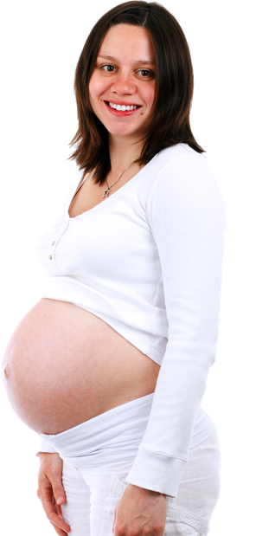
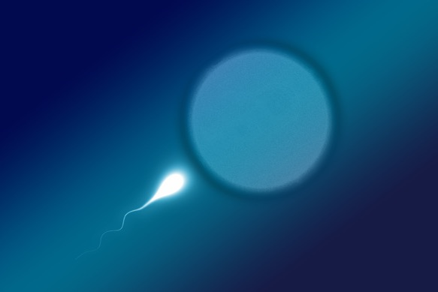
If a man puts his penis inside a woman’s vagina, then his sperm may meet an egg and this is the way a woman can get pregnant and have a baby.
Notes:
Slide 15

