Slide 1
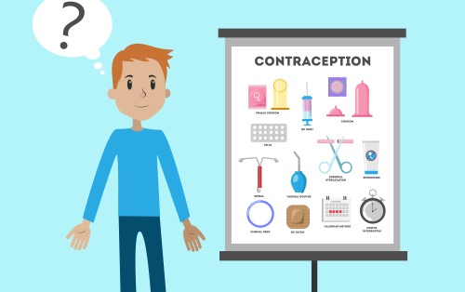

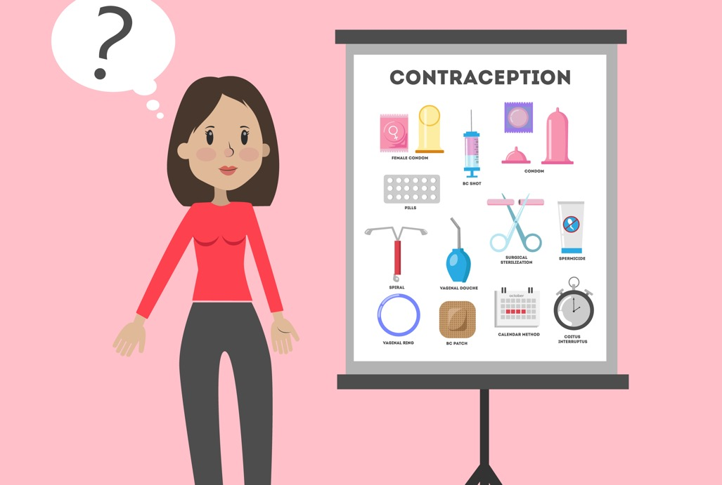
Why do people use contraception?
When a man and woman have sex, the man releases sperm into the woman’s vagina.
If the sperm meets the woman’s egg, she may become pregnant.
If a woman and man are having sex but don’t want to have a baby, then they can use contraception.
The woman and man can talk about what kind of contraception will work best for them.
Notes:
Slide 3

Slide 2
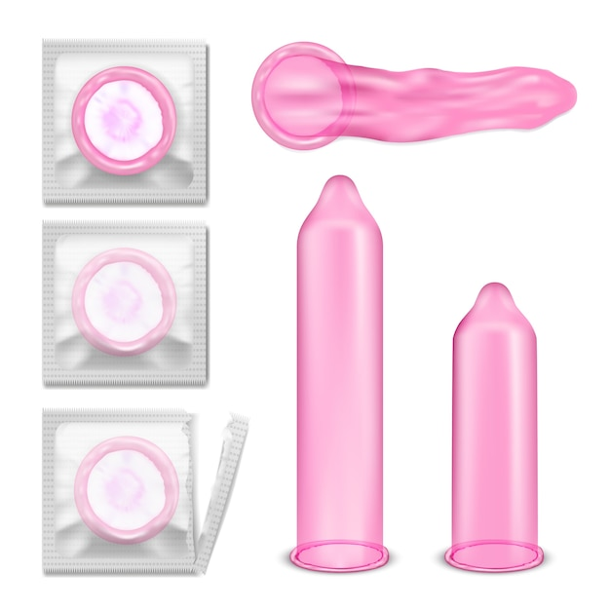
There is only one type of contraception a man can use.
It is called a condom.
A man fits the condom over his penis when it is erect.
During sex, his sperm comes out when he ejaculates. The sperm collects in the condom instead of going into the woman’s vagina.
This helps to stop the sperm meeting the egg.
Notes:
Slide 5
Image by vectorpocket on Freepik - https://www.freepik.com/free-vector/set-vector-illustrations-pink-latex-condoms-packing-without_1320647.htm#query=condom&position=24&from_view=search&track=sph&uuid=11859a95-9cd7-40f2-aca2-438cb8ba532c

Slide 3

There is also a condom for women.
A female (woman’s) condom fits inside her vagina.
During sex, the man’s sperm comes out when he ejaculates. The sperm collects in the condom.
This helps to stop the sperm meeting the egg.
Notes:
Slide 6

Slide 4
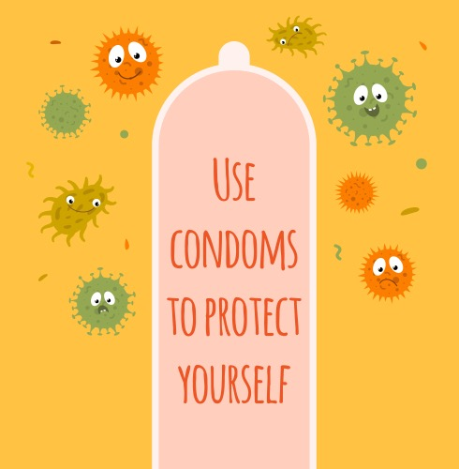
Condoms offer protection too.
If an adult has an infection called a sexually transmitted infection (STI) it can be passed on to another person when they have sex.
If a man or woman uses a condom this helps to protect them from the STI.
Notes:
Slide 7

